Slide 1




Pizza sales report

Slide 2



INTrodUcTIoN

Slide 3
Welcome to the Pizza Sales Analysis project. This project aims to uncover valuable insights from the sales data of a pizza restaurant. By leveraging SQL queries, we analyze key aspects of the business,
including:
Total Orders and Revenue: Understanding the scale of operations.
Popular and Unpopular Pizzas: Identifying customer favorites and less popular items. Order Distribution: Examining when orders are placed to optimize staffing and operations. Financial Contributions: Calculating the revenue contribution of different pizza types.
Customer Preferences: Analyzing preferences for pizza sizes and categories.
Our goal is to transform raw data into actionable insights that drive better business decisions, enhance customer satisfaction, and optimize overall operations.

Slide 4
DATA SET OVERVIEW
Orders Table
order_id: Unique identifier for each order. order_date: Date when the order was placed. order_time: Time when the order was placed.
customer_id: Unique identifier for the customer who placed the order.
Order Details Table
order_details_id: Unique identifier for each order detail entry.
order_id: Unique identifier for the order (foreign key from the Orders table). pizza_id: Unique identifier for the pizza (foreign key from the Pizzas table). quantity: Number of pizzas ordered.

Slide 5
Pizzas Table
pizza_id: Unique identifier for each pizza. name: Name of the pizza.
price: Price of the pizza.
size: Size of the pizza (e.g., Small, Medium, Large).
pizza_type_id: Unique identifier for the pizza type (foreign key from the Pizza Types table).
Pizza Types Table
pizza_type_id: Unique identifier for each pizza type.
category: Category of the pizza (e.g., Vegetarian, Non-Vegetarian, Vegan).

Slide 6
Data Relationships:
Each order in the Orders table can have multiple entries in the Order Details table. Each entry in the Order Details table links to a specific pizza in the Pizzas table.
Each pizza in the Pizzas table belongs to a specific category in the Pizza Types table.
Key Metrics Derived from the Data:
Total Orders Placed: Aggregated count of orders from the Orders table.
Total Revenue: Calculated from the quantity of pizzas ordered and their prices. Most Popular Pizzas: Identified by the highest quantity ordered.
Order Distribution: Analyzed by order date and time.
Revenue Contribution: Breakdown of revenue by different pizza types and sizes.

Slide 7
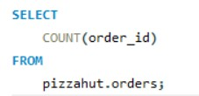
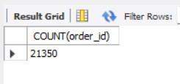
Retrieve the total number of orders placed.

Slide 8
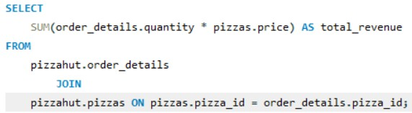

Calculate the total revenue generated from pizza sales.

Slide 9
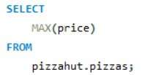
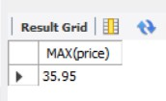
Identify the highest-priced pizza.

Slide 10
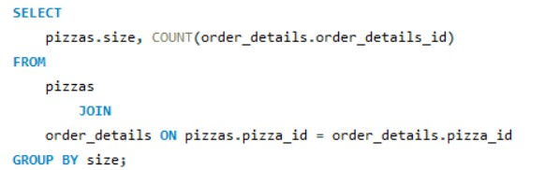
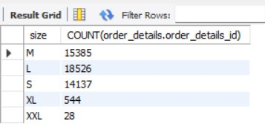
Identify the most common pizza size ordered.

Slide 11
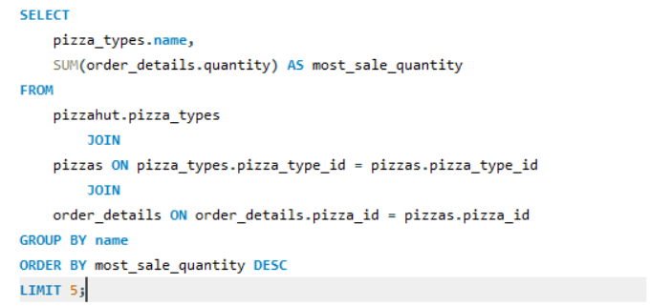
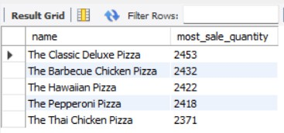
List the top 5 most ordered pizza types along with their quantities.

Slide 12
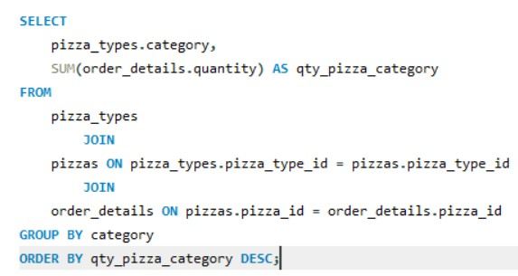
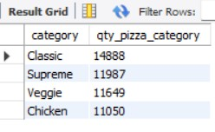
Join the necessary tables to find the total quantity of each pizza category ordered.

Slide 13
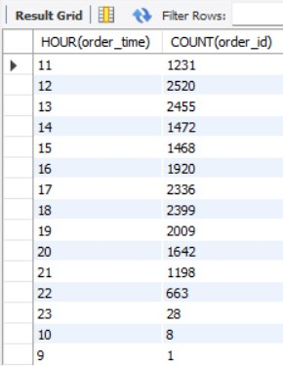
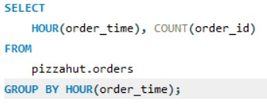
Determine the distribution of orders by hour of the day.

Slide 14
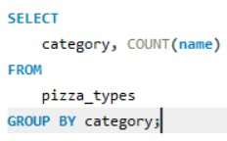
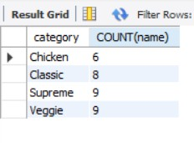
Join relevant tables to find the category-wise distribution of pizzas.

Slide 15
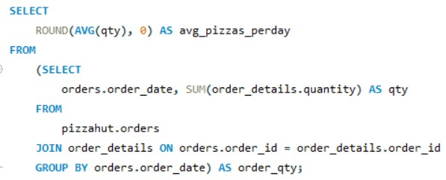

Group the orders by date and calculate the average number of pizzas ordered per day.

Slide 16
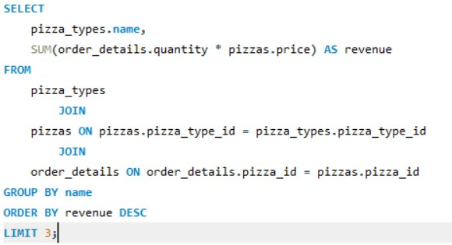
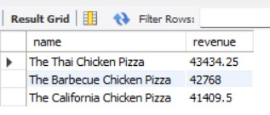
Determine the top 3 most ordered pizza types based on revenue.

Slide 17
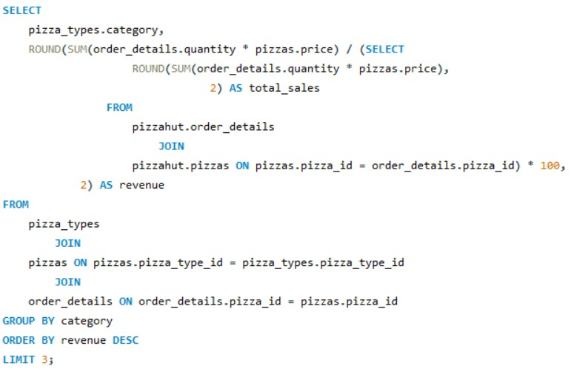
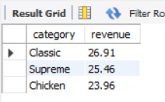
Calculate the percentage contribution of each pizza type to total revenue.

Slide 18
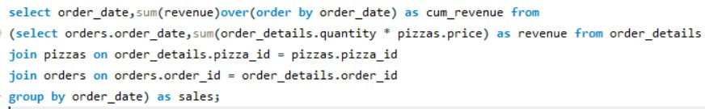
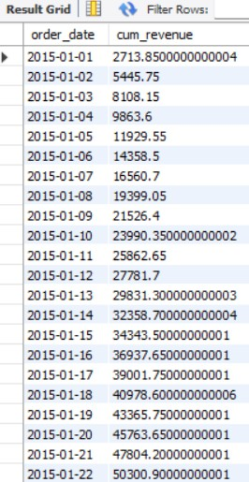
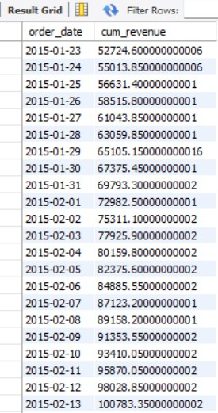
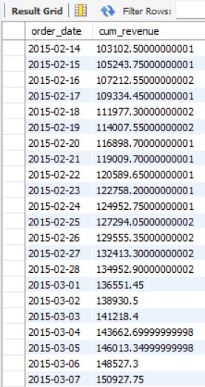
Analyze the cumulative revenue generated over time.
Due to PowerPoint presentation constraints, only the first two months of data are shown to clearly illustrate how the total cumulative revenue builds up day by day.

Slide 19
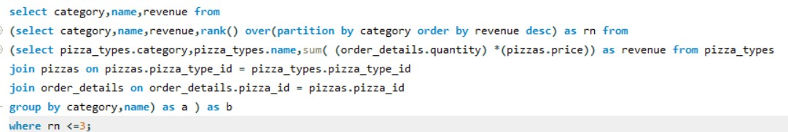
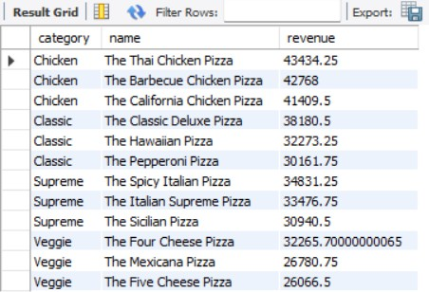
Determine the top 3 most ordered pizza types based on revenue for each pizza category.

Slide 20
ToPIc CoVErd
Mathematical Functions:
Aggregation Functions:
SUM(): Calculates the total of a numeric column. COUNT(): Counts the number of rows or items.
AVG(): Computes the average of a numeric column. MAX(): Finds the maximum value in a column.
MIN(): Finds the minimum value in a column.
Window Functions:
SUM() OVER(): Computes cumulative or running totals. Ranking Functions:
RANK() OVER(): Assigns a rank to each row within a partition of the result set based on the specified order.
Date and Time Functions:
HOUR(): Extracts the hour from a time or timestamp.
ROUND(): Rounds a numeric value to a specified number of decimal places.
Subqueries:
Used for intermediate calculations or filtering results based on aggregated data.
Joins:
JOIN: Combines rows from two or more tables based on a related column.
Grouping and Filtering:
GROUP BY: Groups rows that have the same values in specified columns into summary rows.
HAVING: Filters groups based on aggregate functions.
Ordering and Limiting Results:
ORDER BY: Sorts the result set based on one or more columns. LIMIT: Restricts the number of rows returned.

Slide 21
THaNK YoU
“Have fun making your own pizza and enjoy every bite”

